Slide 1
Electronic Commerce
Lecture 28
Syed Asim Jalal
Department of Computer Science
University of Peshawar

Slide 2
Electronic Commerce
and
Security

Slide 3
Electronic Commerce and Security
Security has been the biggest concern for E-commerce.
Security is an important part of any transaction processing over the Internet.
An E-business cannot succeed without good security mechanisms in place.
E-commerce has seen big growth only after reliable security mechanisms being implemented.

Slide 4
Common Security worries / issues
Secure Transmission
  Payment information (credit/debit card information) stolen from merchant’s computer where they are stored.
Identification of Merchant/Seller
  It is important to confirm the identity of the company/person to whom payment is made.
Secure Storage
  Payment information (credit/debit card information) stolen as it transmits over the internet.

Slide 5
Requirements for secure transactions
Confidential
  Information should not be accessible to unauthorized person. It should not be intercepted during transmission.
Integrity
  Mechanism should be used so that any information should not be altered during its transmission over a network (Internet).
Authenticity
  There should be a mechanism to authenticate user before giving him/her access to required information.

Slide 6
Non-Repudiation
  It is protection against denial of order or denial of payment.
  Once a sender sends a message, the sender should not be able to deny sending the message.
  Similarly the recipient of a message should not be able to deny the receipt of the message.
Availability
  Provide assurance that message/transaction segments are delivered properly so that that message/data is not lost undetectably.

Slide 7
Mechanisms used online for ensuring security
Encryption
Digital Signature
Security Certificates

Slide 8
Encryption
  It is a very effective and practical way to safeguard the data that is transmitted over a communication network.
    Both wired and wireless
  Sender of the data encrypts the data using a secret code.
  Only the specified receiver of that data can then decrypt the data using the same or different a secret code.

Slide 9
Digital Signature
  Digital signature ensures the authenticity of the information.
  Digital Signature confirms the source of some information or data.
  A digital signature is an e-signature authenticated through encryption and password.

Slide 10
Security Certificates
  Security certificate is a unique digital ID used to verify identity of an individual website or user. This is used to prevent people from pretending to be someone else.

Slide 11
Encryption

Slide 12
Encryption
Encryption is coding of some information by using a mathematically based program and a key to produce a string of characters that is unintelligible.
  This key is a secret key.
  A key (the same or a different) is used to decrypt the information
Encryption secures data during transmission.
The science that studies encryption is called cryptography
  The word cryptography comes from combination of the two Greek words krypto and grapho, which mean “secret” and “writing”, respectively. Cryptography is science of creating messages that only the sender and receiver can read.

Slide 13
Cryptography converts normal text to another text in an unintelligible form. The text in the converted form is visible but has no meaning.
The encrypted text/data is called cipher text.
The additional information that is used to encrypt the normal text to cipher text is called encryption key.

Slide 14
Decryption:
  Converting the encrypted text (cipher text) back to the original form is called decryption
  Decryption needs some information about the way the original text was encrypted. This additional information for decrypting in cryptography is called a decrypting key.
  Decrypting key can be the same as encrypting key or can be different.

Slide 15
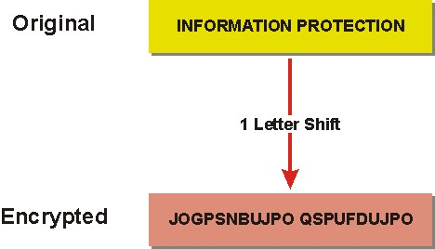
Encryption examples

Slide 16
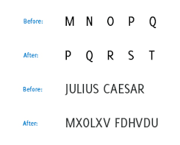
Example: replace each character by 3rd next character

Slide 17
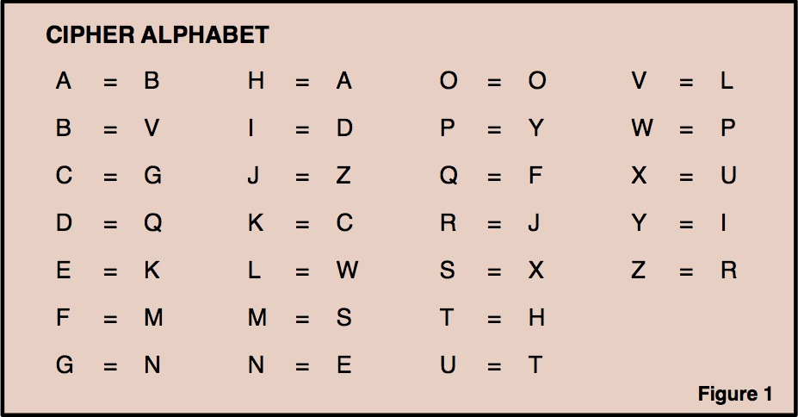
Example: encoding table for encryption

Slide 18
Steganography is another related term.
  Steganography makes text undetectable to bare eyes, for example, information hidden in images.
  You need some hints or may be zooming glasses to view the hidden information.
  There are no encryption and decryption in Steganography.

Slide 19
Keys in Encryption
A encryption key is a value (or string) that is provided to an encryption algorithm (software) to encrypt some text or data.
  This key acts like a ‘password’.
  Encryption keys can be selected (chosen like password) or it can also be generated by algorithms that are designed to ensure that each key is unique and unpredictable.
  The exact implementation of encryption key depends on implementation of the encryption system.
The longer the constructed key is, the harder it is to break it using computer.
  What is breaking a key?

Slide 20
How much time will a super computer of today take to break a 128 bit encryption key (64 characters key)?

Slide 21

Encryption process using key
Message
Cipher text
Internet
Cipher text
Message

Slide 22
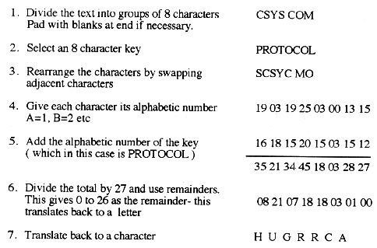
A simple example of encryption using a key

Slide 23
Cryptography (3) Approaches used
Substitution cipher
  Every occurrence of a given letter is replaced by a different letter
Transposition cipher
  Shifts the ordering of letters
    The final text will contain the same characters and only the positions will be changed
Modern cryptosystems
  Digital, based on bits not the alphabet
  The Key length is the length of the string used to encrypt and decrypt.

Slide 24
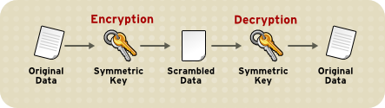
1. Secret-key Cryptography
  Secret key encryption involves the use of a shared key for both encryption by the transmitter and decryption by the receiver.
It is also called Symmetric-key cryptography or Private-key encryption
    Same key to encrypt and decrypt messages
    Sender sends message and key to receiver

Slide 25
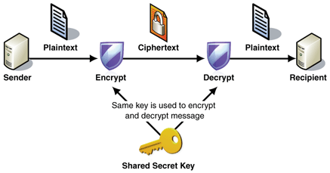

Slide 26
Some problems with secret-key cryptography
  The Key must be transmitted to the receiver for decryption
  There must be a different key for every receiver

Slide 27
The transmitter uses a cryptographic secret key to encrypt the message and the recipient must use the same key to decipher or decrypt it.
All parties must know and trust each other completely.
  That the key will not be share with third person.
All parties must have in their possession a protected copy of the key.
Anyone who over hears or intercepts the key in transit can later use that key to read all encrypted messages.

Slide 28
In the context of E-commerce, each merchant should have a different key for doing transactions with each customer
  This is very complex and difficult task and it is not feasible in the context of e-commerce.
  For example a merchant cannot have millions of keys one for each customer.

Slide 29
2. Public Key encryption
It is also called Asymmetric Key cryptography
  Here we have two different keys, Public key and Private Key
  The two keys are mathematically related so that data encrypted with one key can only be decrypted using the other key.
    One key for encryption and another for decryption
  Either the public key or the private key can be used to encrypt a message

Slide 30
  One of the two keys is public and the other is private.
  The public key is made known to all other parties.
  The private key must be kept confidential and must be known only to its owner.

Slide 31
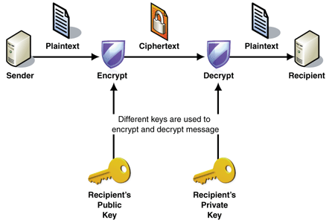

Slide 32
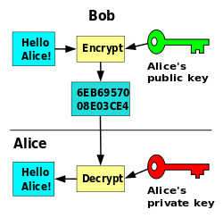
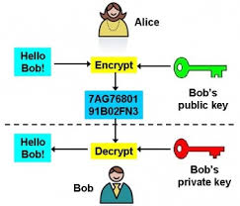

Slide 33
If an individual wants to send a secret email to a friend, he simply looks up his public key and uses that key to encrypt her text.
When the friend receives the email, he uses his own private key to convert the encrypted message on his computer screen back to the sender’s original message in clear text.
Since only the intended user has knowledge of the private key therefore only he can decrypt the message.
If a criminal intercepts the message during transmission he has no way to decipher it.

Slide 34
Example of public key encryption
In 1977, the RSA Public Key Cryptosystem was invented.
  RSA is the name of the Algorithm
  It is one of the most popular security algorithms
The RSA algorithm can be used for both public key encryption and digital signatures.

Slide 35
Comparing Asymmetric and Symmetric Encryption Systems
Public-key (asymmetric) systems provide several advantages over private-key (symmetric) encryption methods.
  First, the combination of keys required to provide private messages between enormous numbers of people is small.
    If n people want to share secret information with one another, then only n unique public-key pairs are required.

Slide 36
  Second, key distribution is not a problem. Each person’s public key can be posted anywhere and does not require any special handling to distribute.
    In symmetric system, sending the shared key is a big problem.
  Third, public-key systems make implementation of digital signatures possible.
    This means that an electronic document can be signed and sent to any recipient with non-repudiation.

Slide 37
Drawback of Public Key Encryption:
Public-key encryption and decryption systems are significantly slower than symmetric keys system (private-key) systems.
  In order to use advantages of both systems, they are also used together.
  Message is encrypted using symmetric encryption and the shared key is decrypted using asymmetric keys.

Slide 38
Features | Secret key | Public key
Number of keys | Single key | Pair of keys
Types of keys | Key is secret | One key is private and one is public
Key management | Simple but difficult to manage for large number of senders and receivers | Need digital certificates and trusted third parties
Relative Speeds | Very fast | Slower
Usage | Used for bulk data | Used for less demanding applications such as encrypting small documents or to sign messages

Slide 39
Implementation of digital signature using Public Key Encryption
    Digital Signature
      Digital Signature is encrypting some well known information with own private key.
      The receiver simply decrypts the known message using the owner’s public key. (which is publically available)
      If the message decrypts successfully with the public key of the person claiming to sign the document, then it confirms the identity of the senders.

Slide 40
Combined Shared-Key and Public-Key Cryptography

Slide 41
Combining shared key and public key cryptography
Usually when large amount of encrypted data need to be sent then both shared key and public key encryption is used.
The data is encrypted using shared key cryptography technique through some shared key
The shared key itself is shared using public key encryption. The public key of the receiver is used.
At the receiver end the encrypted key is decrypted by the receiver using its own private key.
The decrypted key is then used to decrypted the data

Slide 42
Benefits:
  More secure due to use of public key cryptography
  Faster performance due to encrypting data using shared key cryptography
    (Shared key cryptography is faster in performance than public key methods)

Slide 43
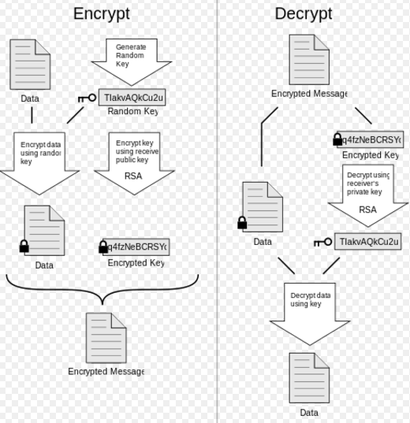
Shared key/
Secret key
Shared key/
Secret key

